Slide 1


COVID-19 SCAN DETECTION USING CNN
Medical Robotics
Vision and Perception course - Project presentation
Flavio Lorenzi
Michele Ciciolla
Nicolò Mantovani
Notes:
1
1

Slide 2



How the presentation is organized
Section 1 - The Chosen Dataset & Background
Section 2 - The PreTrained CNN Network - ResNet101
Section 3 - Our custom CNN Network
Vision and Perception - Presentation
2

Slide 3
How the presentation is organized
Section 1 - The Chosen Dataset & Background
Section 2 - The PreTrained CNN Network - ResNet101
Section 3 - Our custom CNN Network
Vision and Perception - Presentation
3

Slide 4
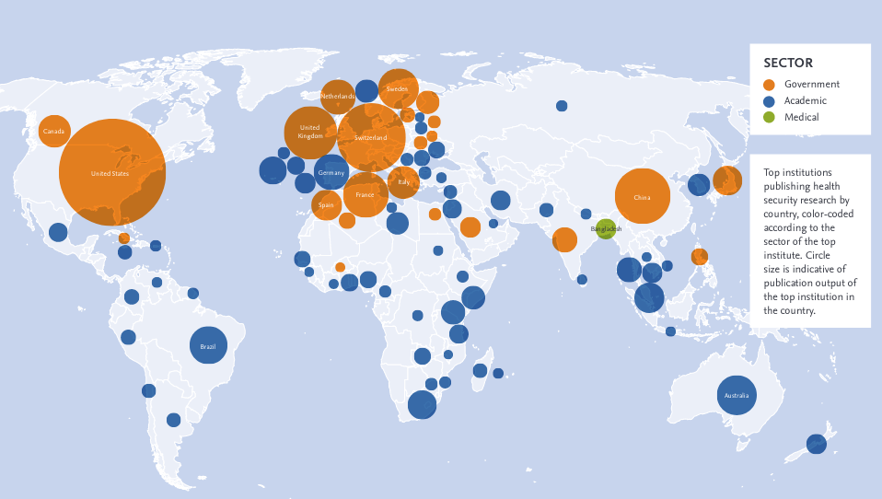
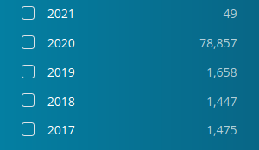
Section 1 - The Community Effort
researchers worldwide have been working to advance our understanding of these epidemics and how to respond
elsevier.com/connect/infographic-global-research-trends-in-infectious-disease
Vision and Perception - Presentation
4

Slide 5

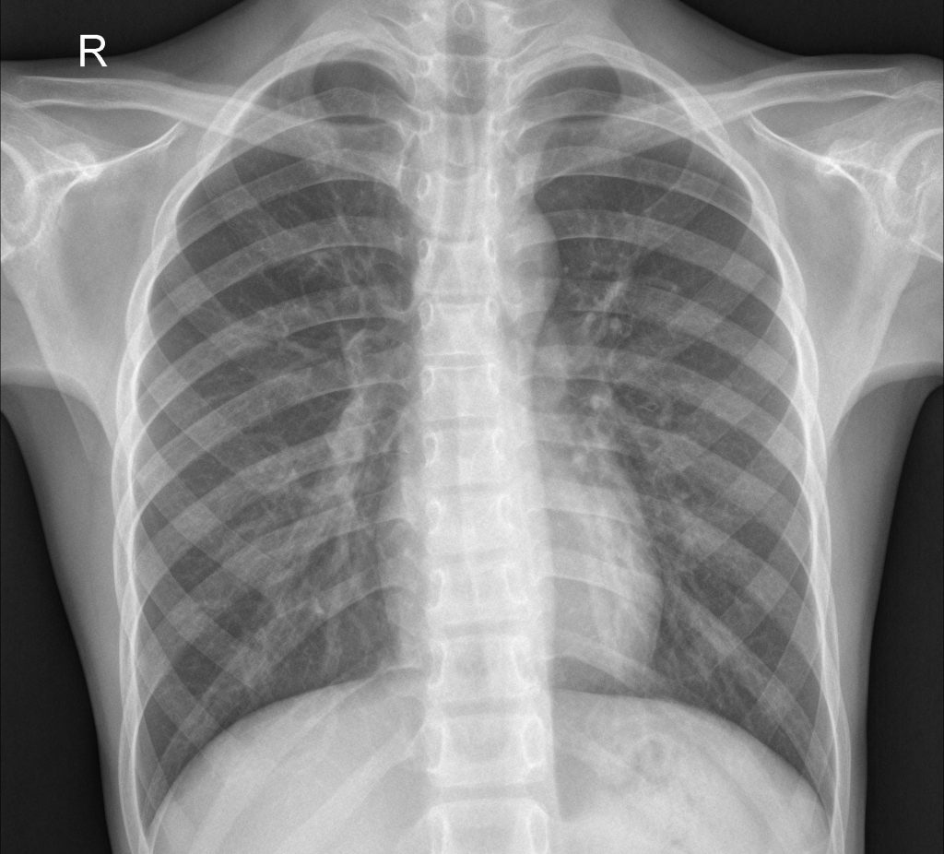
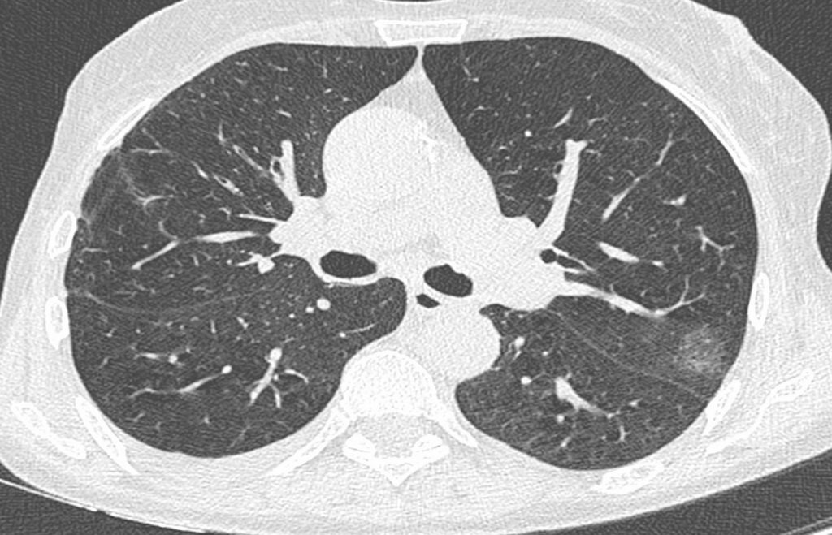
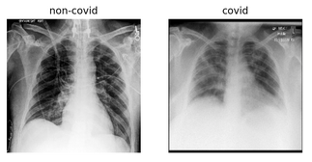
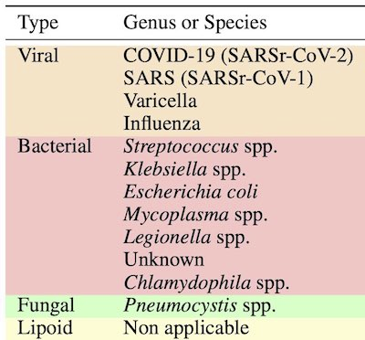
Section 1 - The task
A fast classification of the radiological imaging such as chest X-ray and chest CT-scan can be helpful to isolate the infected persons timely and control this epidemic situation
binary classification
multiclass classification
Vision and Perception - Presentation
5

Slide 6
Section 1 - The task
A fast classification of the radiological imaging such as chest X-ray and chest CT-scan can be helpful to isolate the infected persons timely and control this epidemic situation
binary classification
multiclass classification
Vision and Perception - Presentation
6

Slide 7
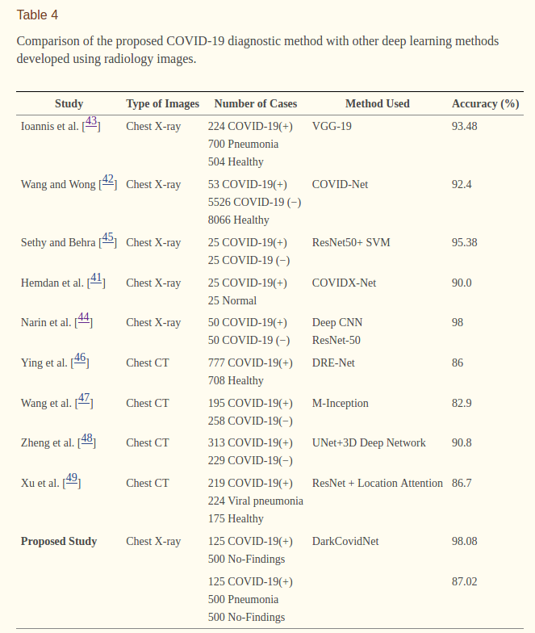
Section 1 - The task
Vision and Perception - Presentation
7

Slide 8
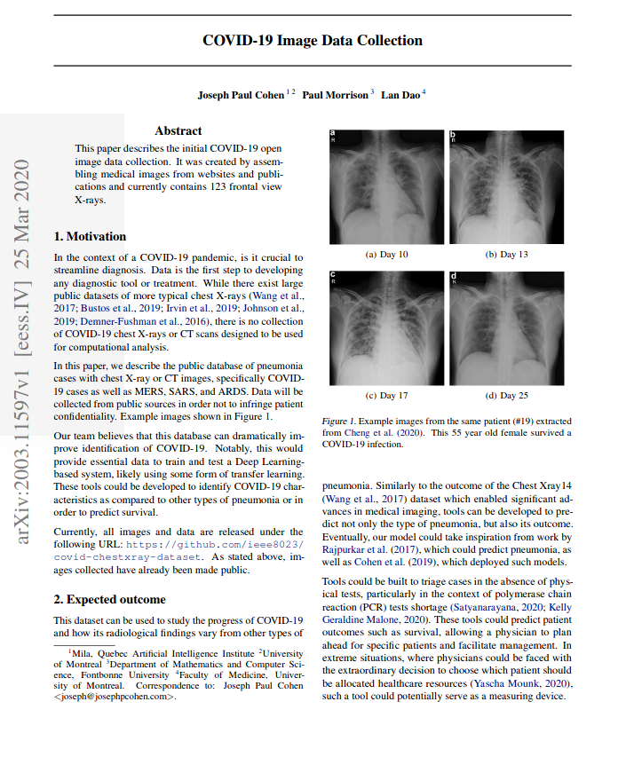
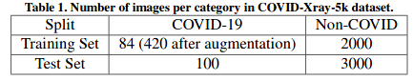
Section 1 - The Chosen Dataset (1)
We collected scan images found attached to this research paper
Different resolutions from (255, 249) up to (4280, 3520)
COVID-Xray-5k dataset
with 184 samples containing clinical findings of COVID-19 from 216 patients
Vision and Perception - Presentation
8

Slide 9
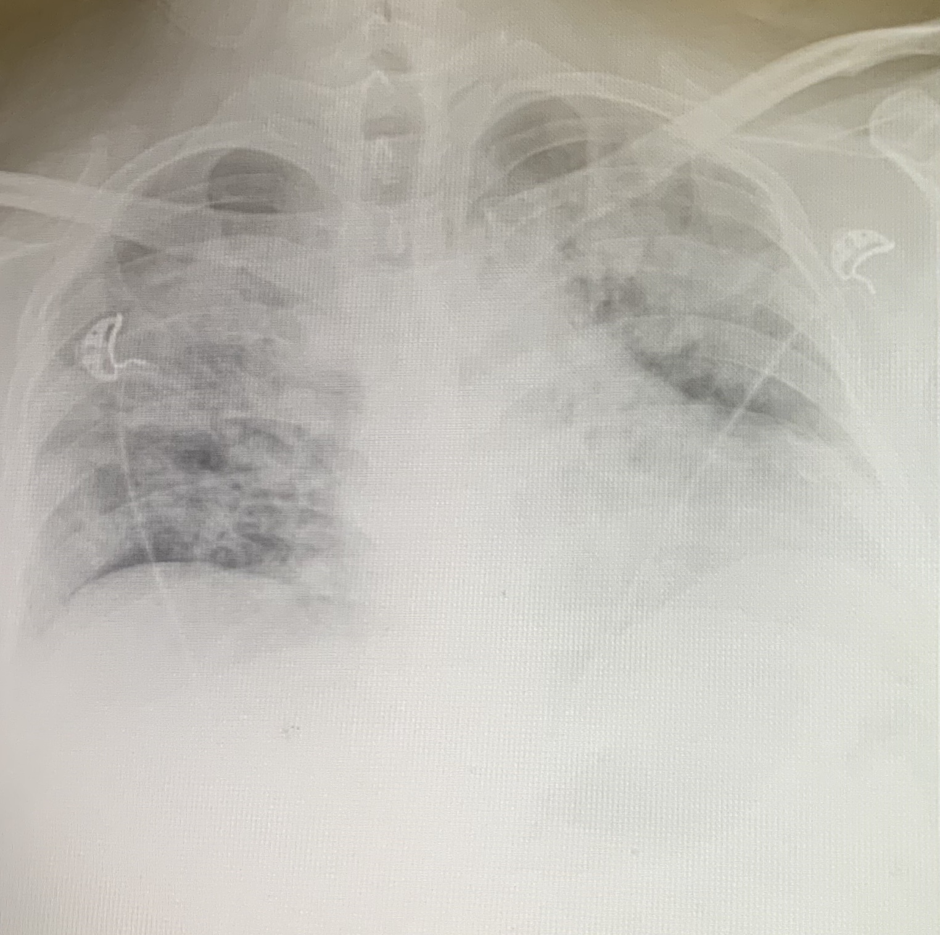
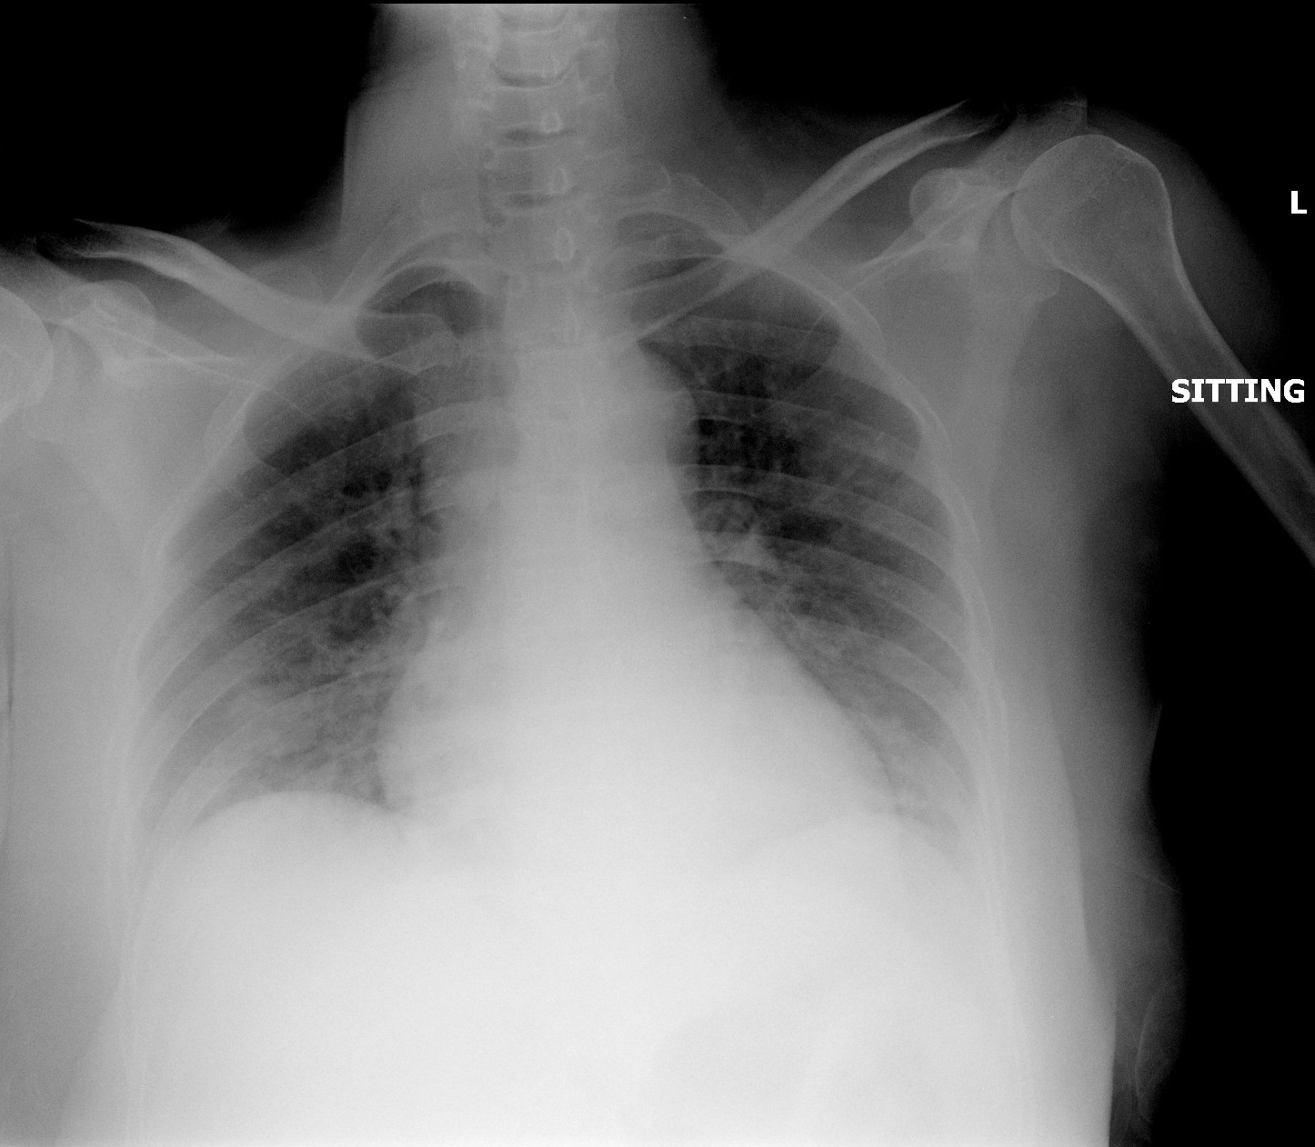
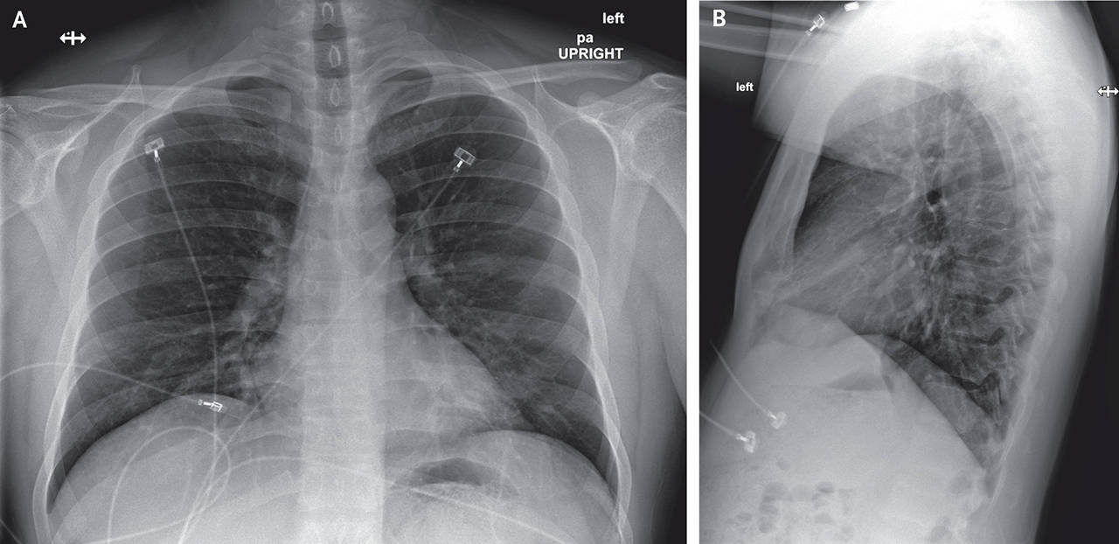
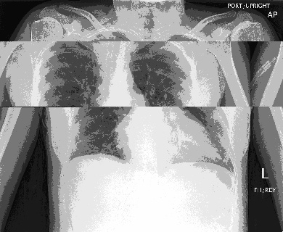
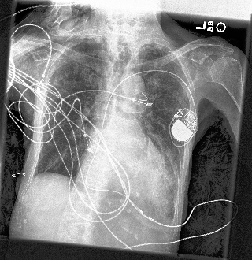
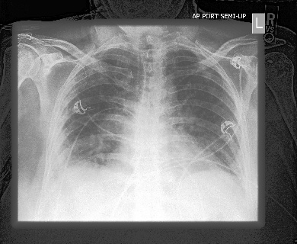
Section 1 - The Chosen Dataset (2)
Different resolutions from (255, 249) up to (4280, 3520)
COVID-Xray-5k dataset
with 84 CT images containing clinical findings of COVID-19 from 216 patients
Vision and Perception - Presentation
9

Slide 10



Section 1 - The Chosen Dataset (2)
We obtained 1140 images from the initial dataset of 184 after the data augmentation phase
rotation = (few degrees) size preserving rotation
flip_left_right = mirroring
centered crop
contrast jitter = contrast alteration
Vision and Perception - Presentation
10

Slide 11
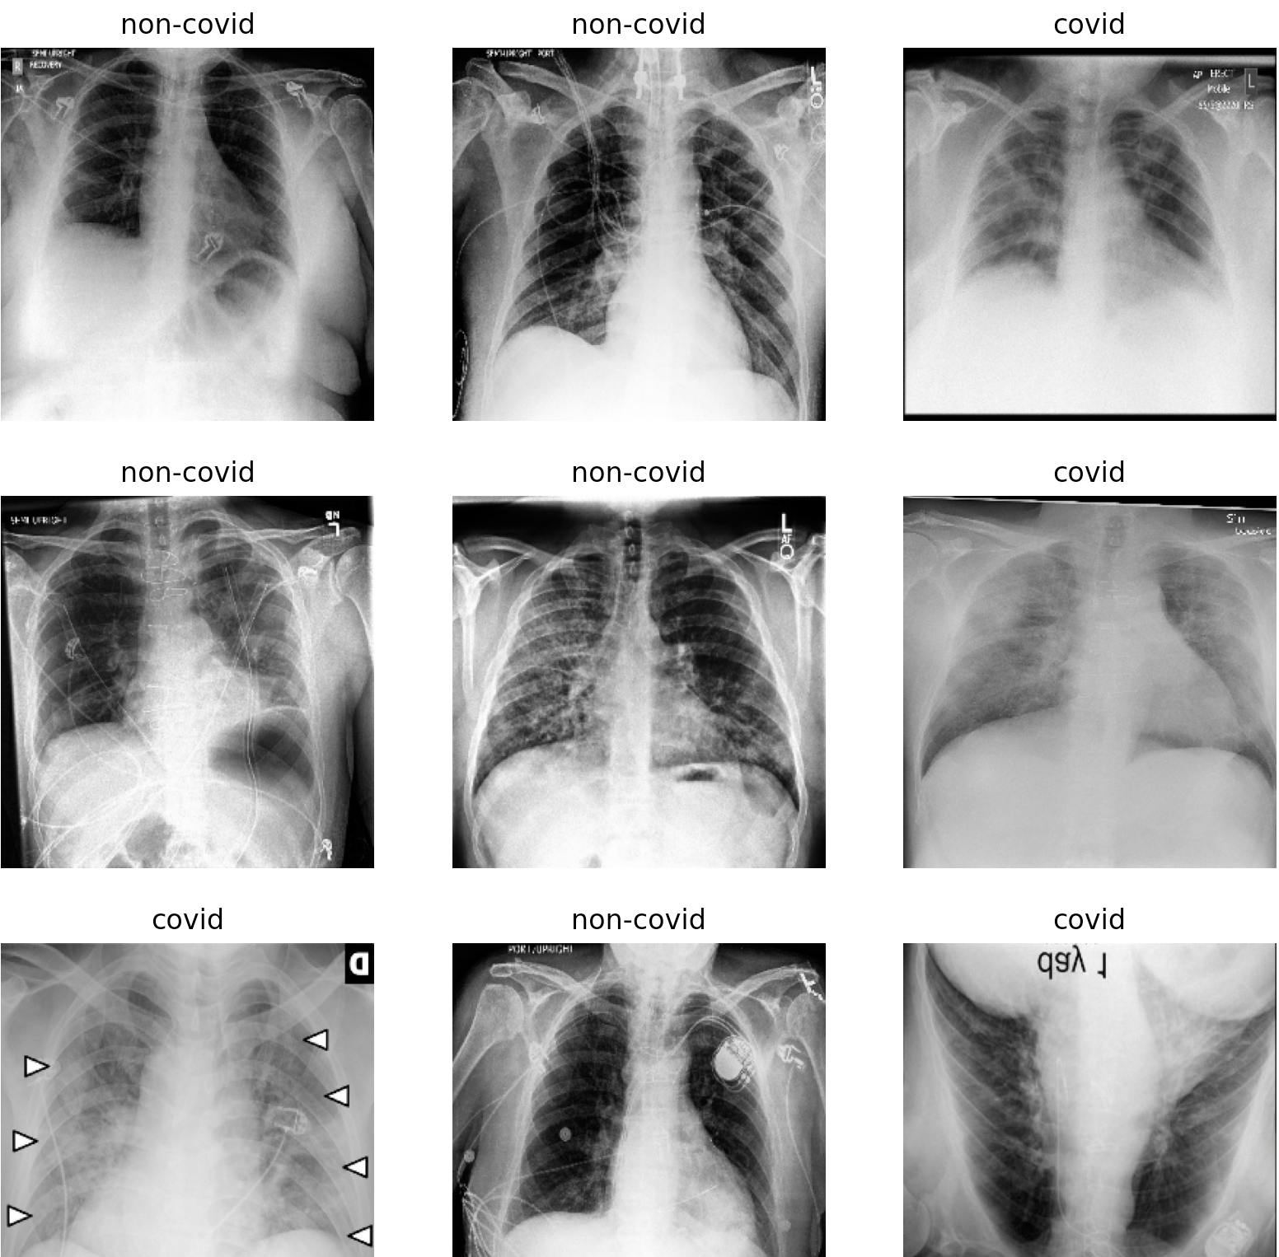
Section 1 - The Chosen Dataset ()
pros:
community effort
sharing is caring
cons:
few images
overfitting
need doctors supervision
Vision and Perception - Presentation
11

Slide 12
How the presentation is organized
Section 1 - The Chosen Dataset & Background
Section 2 - The PreTrained CNN Network - ResNet101
Section 3 - Our custom CNN Network
Vision and Perception - Presentation
12

Slide 13
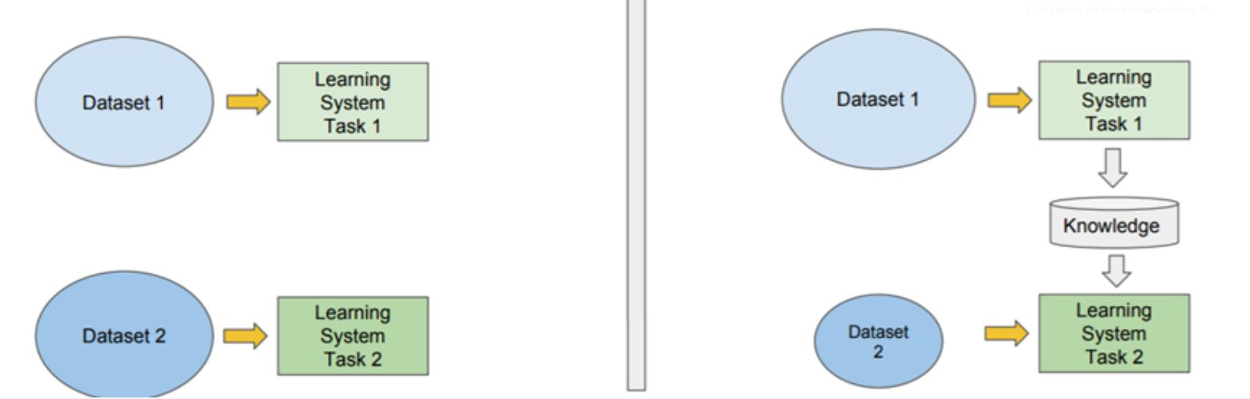
Section 2 - The PreTrained CNN Network - ResNet101 (1)
Traditional Machine Learning
Isolated
Single Task Learning
Knowledge not accumulated
Transfer Learning
Learning relies on previously learned tasks
Learning process faster
More accurate
Less train data
vs
Vision and Perception - Presentation
13

Slide 14
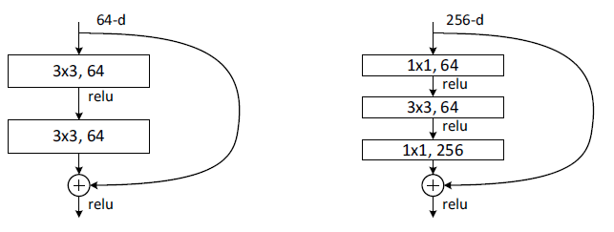
Section 2 - The PreTrained CNN Network - ResNet101 (1)
“Depth Revolution”
Vanishing/exploding gradient
Residual Network:
Identity Mapping
One projection, other identity
All projections
Bottleneck design
x
F(x)
x
identity
H(x) = F(x)+x

Slide 15
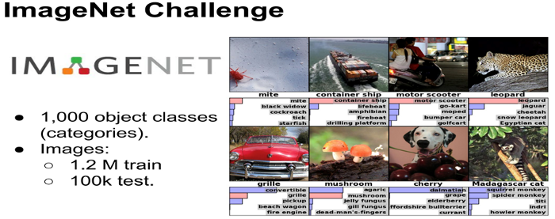
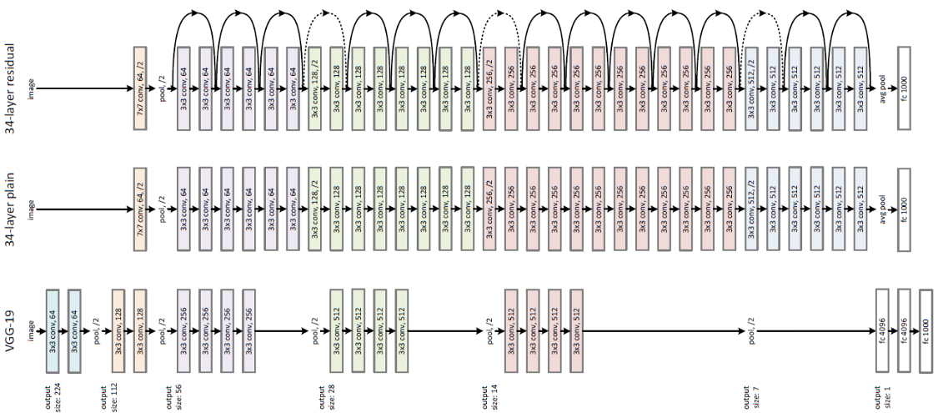
Section 2 - The PreTrained CNN Network - ResNet101 (2)
Hyperparameters:
Epochs : 50
Batch_size : 64
Optimizer : SGD
Learning rate : 10^-3
Loss : CrossEntropy
Momentum: 0.9
Vision and Perception - Presentation
15

Slide 16

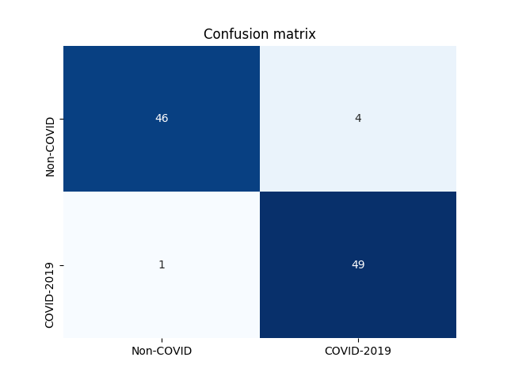
Section 2 - The PreTrained CNN Network - ResNet101 (3)
 | MIRRORING | MIRRORING ROTATION | MIRRORING ROTATION CONTRAST JITTER | MIRRORING ROTATION CONTRAST JITTER CROP
SENSITIVITY (TP/P) | 0.75 | 0.785 | 0.84 | 0.9
SPECIFICITY (TN/N) | 0.94 | 0.96 | 0.97 | 0.99
ACCURACY (TP+TN)/(TOT) | 0.845 | 0.872 | 0.905 | 0.945
sensitivity : 0.98
specificity : 0.92
accuracy : 0.95
f1_score : 0.9514
Vision and Perception - Presentation
16

Slide 17
How the presentation is organized
Section 1 - The Chosen Dataset & Background
Section 2 - The PreTrained CNN Network - ResNet101
Section 3 - Our custom CNN Network
Vision and Perception - Presentation
17

Slide 18
Section 3 - Our custom CNN Network (1)
Major issues due to the small dataset:
Overfitting
Vanishing gradient
Oscillations in both training and testing
model = tf.keras.Sequential([
data_augmentation,
layers.experimental.preprocessing.Rescaling(1./255)
layers.Conv2D(16, 5, padding=’valid’, activation=’relu’),
layers.MaxPooling2D( (2,2) ), #stride default
layers.BatchNormalization(momentum=0.8),
layers.Conv2D(32, 3, padding=’same’, activation=’relu’),
layers.MaxPooling2D( (2,2) ), #stride default
layers.BatchNormalization(momentum=0.8),
layers.Conv2D(64, 3, padding=’same’, activation=’relu’),
layers.MaxPooling2D( (2,2) ), #stride default
layers.BatchNormalization(momentum=0.8),
layers.Conv2D(128, 3, padding=’same’, activation=’relu’),
layers.MaxPooling2D( (2,2) ), #stride default
layers.BatchNormalization(momentum=0.8),
layers.Dropout(0.5),
layers.Flatten(),
layers.Dense(256, activation=’relu’) #First FC layers
layers.Dense(2) #second FC. 2 is our #classes
])
Solutions adopted:
Batch normalization
L2 weight decay
Dropout
Vision and Perception - Presentation

Slide 19
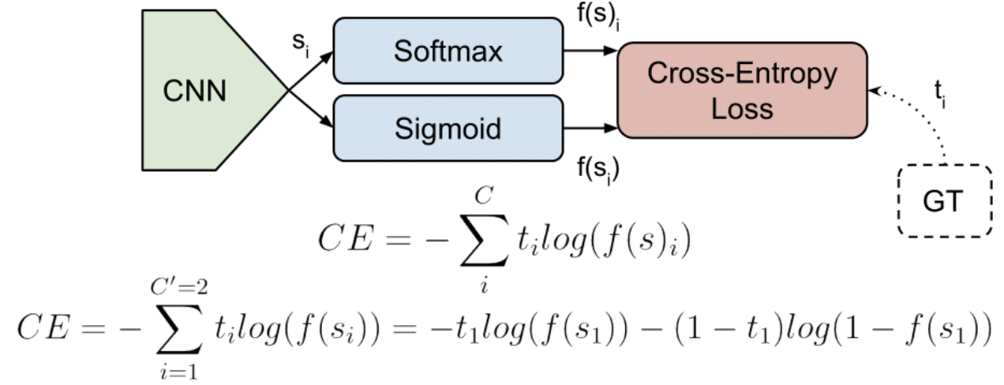
Section 3 - Our custom CNN Network (2)
Loss function experiments:
BinaryCrossEntropy
CategoricalCrossentropy (Sparse)
The first iterates over two classes (0,1) so it works well with a sigmoid before computation.
The second is meant for two or more classes, so take advantage of a softmax activation.
Vision and Perception - Presentation
19

Slide 20
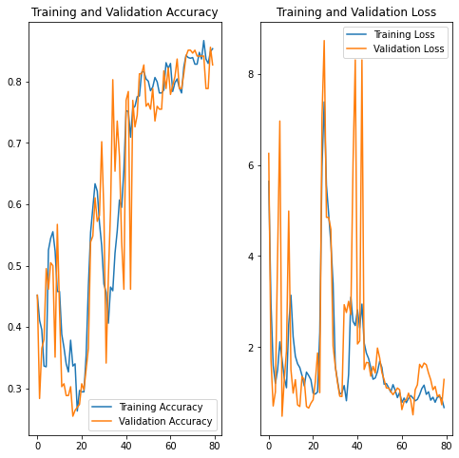
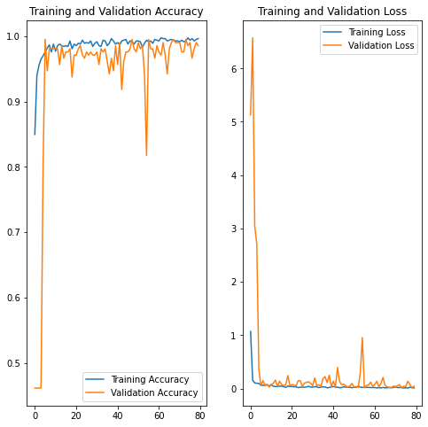
Section 3 - Our custom CNN Network (3)
Binary Cross Entropy (best results after a very long hyperparams tuning)
Sparse Categorical Cross Entropy (one of the first obtained results: only 2 epochs to achive an optimal val_acc)
Vision and Perception - Presentation
20

Slide 21
Section 3 - Our custom CNN Network (4)
Data augmentation experiments:
 | MIRRORING | MIRRORING ROTATION | MIRRORING ROTATION CONTRAST JITTER | MIRRORING ROTATION CONTRAST JITTER CROP
SENSITIVITY (TP/P) | 0.71 | 0.75 | 0.78 | 0.86
SPECIFICITY (TN/N) | 0.93 | 0.95 | 0.96 | 1.0
ACCURACY (TP+TN)/(TOT) | 0.82 | 0.85 | 0.87 | 0.93
Note: some other techniques have been tried, but not relevant in terms of network accuracy
Vision and Perception - Presentation
21

Slide 22
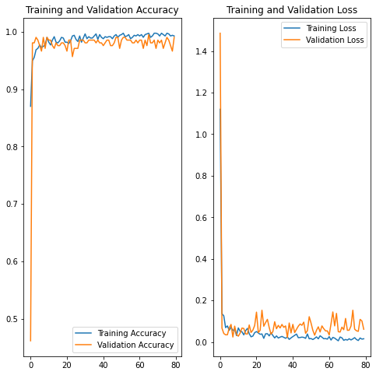
Section 3 - Our custom CNN Network (5)
Best Model
Conv2D: (16) (32) (64) (128)
Dense_1: (256)
Dense_2: (2)
(Not so deep, but very efficient)
Batch size: 64
Epochs: 80
Dropout: 0.5
Batch norm. momentum: 0.8
Loss: sparse categorical cross entropy
Optimizer: Adam with 0.9 LR decay rate
Starting LR: 1e^-2
Activation function: relu
Vision and Perception - Presentation
22

Slide 23
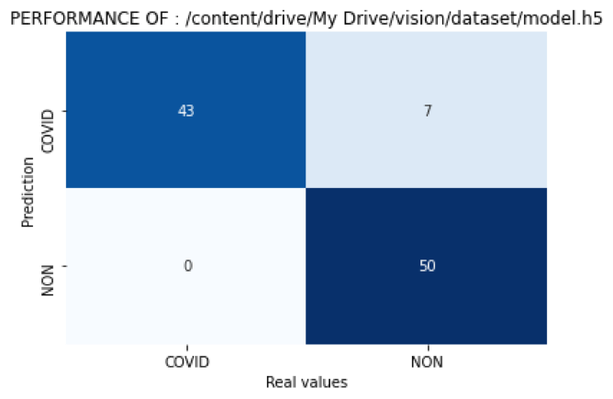
Section 3 - Our custom CNN Network (6)
To have a practical response of it, a brief inference part is realized, with very good results
sensitivity : 0.86
specificity : 1.0
accuracy : 0.93
f1_score : 1.0
The blind testset is the same we used for the first part (with the transfer learning), to make also a further comparison
Confusion Matrix
Vision and Perception - Presentation
23

Slide 24
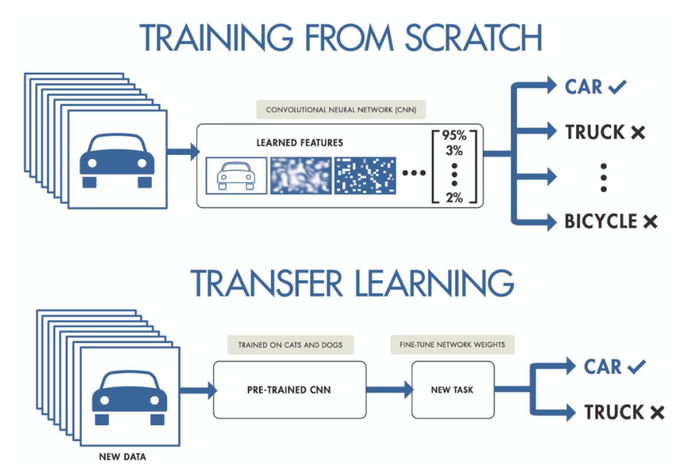

Final considerations
best model accuracy: 0.93
best model accuracy 0.95
Future Works:
extend the dataset
multiclass classification (covid, pneumonia, pneumothorax …)
Vision and Perception - Presentation
24

Slide 25
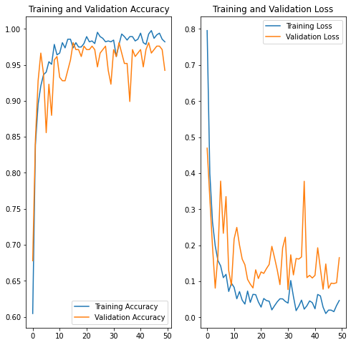
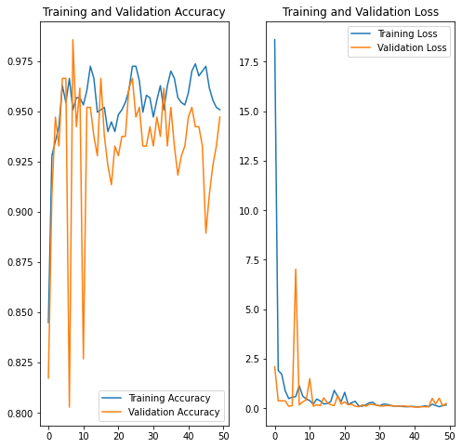
Appendix: additional exp. fail plots (1)
Conv2D: 16 32 64 128
No batch normalization, no LR decay
Very long training time
Good accuracy but unstable: bad inference
Conv2D: 16 32 64 128 256
First introduction of the batch norm
Very unstable training, bad inference
Vision and Perception - Presentation
25

Slide 26
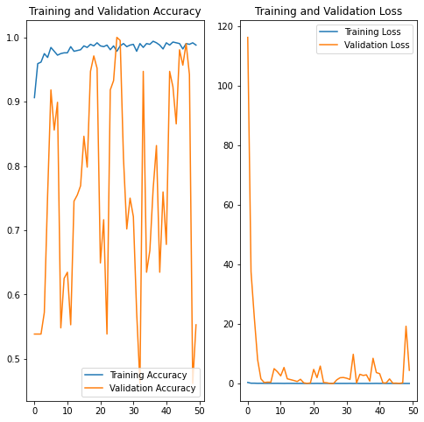
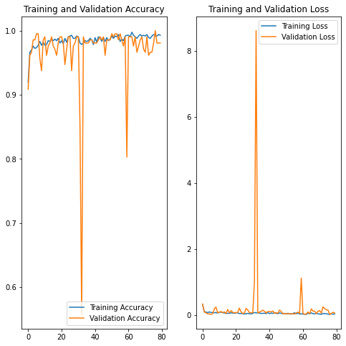
Appendix: additional exp. fail plots (2)
Deep network (32 32 64 64 … 512)
No data augmentation
Batch size big, small b.n. momentum
LR: 0.1 without decay (very unstable net)
Standard network (shown before)
Batch norm before max pooling
No LR decay: instability
Inference not so bad
Vision and Perception - Presentation
26

Slide 27

THANKS FOR
YOUR
ATTENTION
Lorenzi – Mantovani – Ciciolla

